Slide 1

Database Management Systems
Shamim Ahmad

Slide 2
Example ER Design

Slide 3
Constructing an ER model
Before beginning to draw the ER model, read the requirements specification carefully.
Document any assumptions you need to make.

Slide 4
Constructing an ER model (cont)
1. Identify entities - list all potential entity types. These are the object of interest in the system. It is better to put too many entities in at this stage and them discard them later if necessary.

Slide 5
Constructing an ER model (cont)
2. Remove duplicate entities - Ensure that they really separate entity types or just two names for the same thing.
Also do not include the system as an entity type
e.g. if modelling a library, the entity types might be books, borrowers, etc.
The library is the system, thus should not be an entity type.

Slide 6
Constructing an ER model (cont)
3. List the attributes of each entity (all properties to describe the entity which are relevant to the application).
Ensure that the entity types are really needed.
are any of them just attributes of another entity type?
if so keep them as attributes and cross them off the entity list.
Do not have attributes of one entity as attributes of another entity!

Slide 7
Example Scenario:
University Course Registration System
Students register for courses taught by instructors in departments.

Slide 8
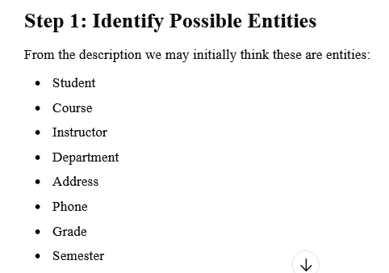

Slide 9
Constructing an ER model (cont)
4. Mark the primary keys.
Which attributes uniquely identify instances of that entity type?
This may not be possible for some weak entities.

Slide 10
Constructing an ER model (cont)
5. Define the relationships
Examine each entity type to see its relationship to the others.

Slide 11
Constructing an ER model (cont)
6. Describe the cardinality and optionality of the relationships
Examine the constraints between participating entities.

Slide 12
Constructing an ER model (cont)
7. Remove redundant relationships
Examine the ER model for redundant relationships.

Slide 13
Constructing an ER model (cont)
ER modelling is an iterative process
So draw several versions, refining each one until you are happy with it
Note that there is no one right answer to the problem, but some solutions are better than others!

Slide 14
Problem (story) : National Bus Company
The DeSh Travells owns a number of busses. Each bus is allocated to a particular route, although some routes may have several busses. Each route passes through a number of towns.

Slide 15
Problem (story) : National Bus Company
One or more drivers are allocated to each stage of a route, which corresponds to a journey through some or all of the towns on a route.

Slide 16
Problem (story) : National Bus Company
Some of the towns have a garage where busses are kept and each of the busses are identified by the registration number and can carry different numbers of passengers, since the vehicles vary in size and can be single or double-decked.

Slide 17
Problem (story) : National Bus Company
Each route is identified by a route number and information is available on the average number of passengers carried per day for each route. Drivers have an employee number, name, address, and sometimes a telephone number.

Slide 18
Solution: Entities
Bus - Company owns busses and will hold information about them.
Route - Buses travel on routes and will need described.
Town - Buses pass through towns and need to know about them
Driver - Company employs drivers, personnel will hold their data.
Stage - Routes are made up of stages
Garage - Garage houses buses, and need to know where they are.

Slide 19
Solution: Relationships
A bus is allocated to a route and a route may have several buses.
Bus-route (m:1) is serviced by
A route comprises of one or more stages.
route-stage (1:m) comprises
One or more drivers are allocated to each stage.
driver-stage (m:1) is allocated
A stage passes through some or all of the towns on a route.
stage-town (m:n) passes-through

Slide 20
Solution: Relationships (cont)
A route passes through some or all of the towns
route-town (m:n) passes-through
Some of the towns have a garage
garage-town (1:1) is situated
A garage keeps buses and each bus has one `home' garage
garage-bus (m:1) is garaged

Slide 21
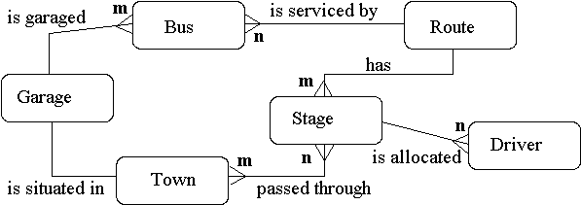
Solution: Draw E-R Diagram

Slide 22
Solution: Relations
Bus (reg-no,make,size,deck,no-pass)
Route (route-no,avg-pass)
Driver (emp-no,name,address,tel-no)
Town (name)
Stage (stage-no)
Garage (name,address)

Slide 23
Banking System Design

Slide 24
Defining Entities
A thing in the real world with an independent existence. It is may be an object with physical existence (ex: house, person) or with a conceptual existence (ex: course, job). The are represented by rectangle.
Entities for Bank are:
Bank, Branch, Employee, customer, loan, account.

Slide 25
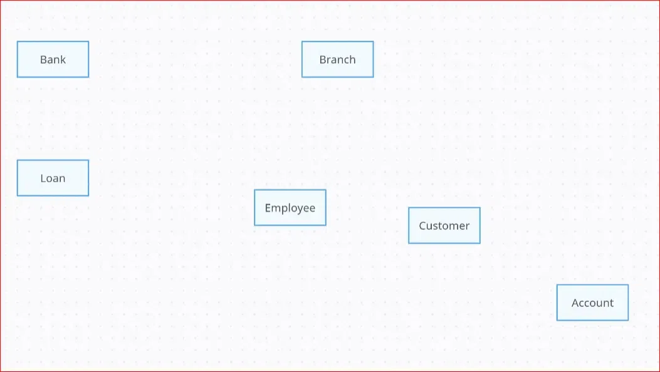

Slide 26
Adding Attributes
Attributes are the kind of properties that describe the entities. They are represented by ovals.
Attributes for Bank are:
For Bank Entity the Attributes are Bname, code.
For Branch Entity the Attributes are Blocation, Bname.
For Employee Entity the Attributes are Eid, Designation, salary.
For Customer Entity the Attributes are Cid, Cname, Address, DOB.
For Loan Entity the Attributes are Loan_no, amount, rate.
For Account Entity the Attributes are acc_no, type.

Slide 27
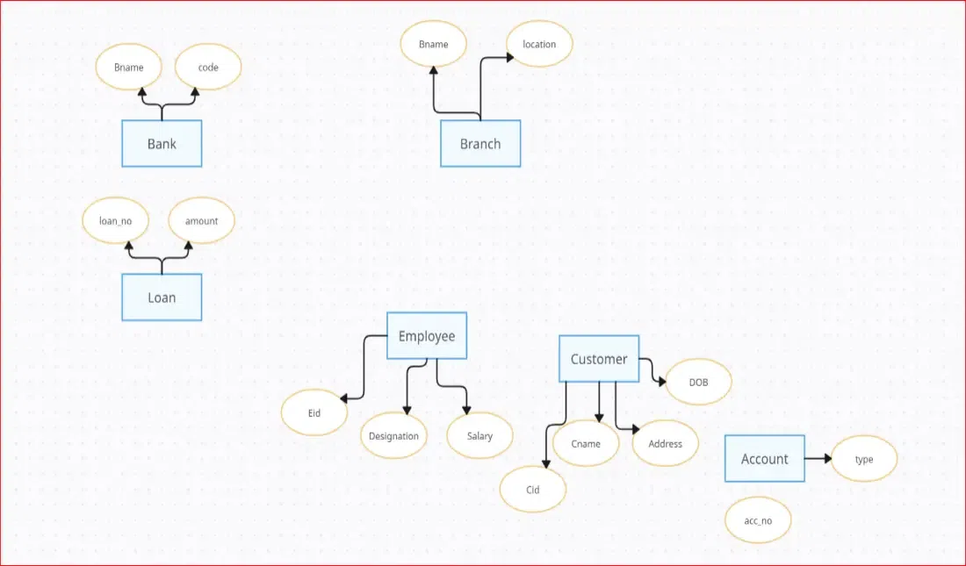

Slide 28
Establishing Relationships
Entities have some relationships with each other. Relationships define how entities are associated with each other.
Let's Establishing Relationships between them are:
The Bank has branches.
The Branch provides loan.
The Employee works in branch.
The Branch contains customers.
The Customers has account.
The Branch maintains account.
The Customer avails loan.

Slide 29
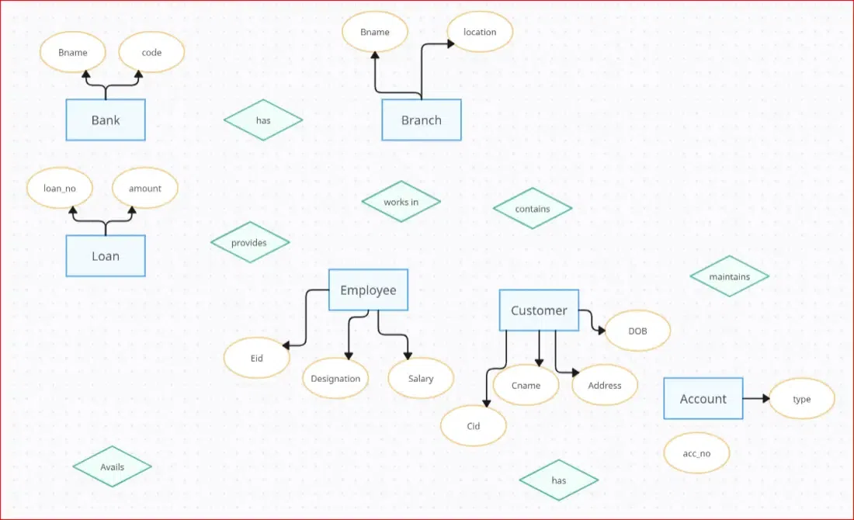

Slide 30
Specify cardinality for Bank:
Bank and branch has One to Many relationship (a bank has multiple branches).
Branch and loan has also One to Many relationship(one branch can provide multiple loans).
Branch and employee has One to Many relationship(one branch employs multiple employees).

Slide 31
Branch and account has One to Many relationship(one branch maintains multiple accounts).
Branch and customer has One to Many relationship(one branch has multiple customers; each customer belongs to one primary branch).
Customer and account has One to Many relationship(one customer can have multiple accounts, each account belongs to exactly one customer).
Customer and loan has One to Many relationships(each customer can have multiple loans; each loan belongs to exactly one customer)

Slide 32
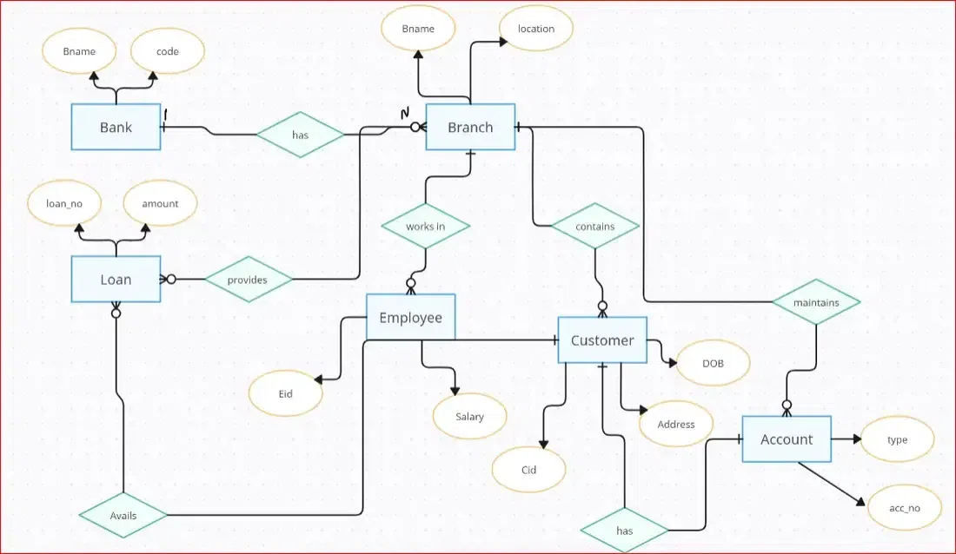

Slide 33
Identify Primary Keys
Primary keys are the unique identifier for each record in database table. It is denoted by an underline under the attribute name.
The Primary key of Bank is code.
The Primary key of Branch is branch_code.
The Primary key of Employee is Eid.
The Primary key of Customer is Cid.
The Primary key of Loan is loan_no.
The Primary key of Account is acc_no

Slide 34
